Slide 1
Design a effective marketing campaign
Bellabeat fitness technology
Harish P | 27 May 2022

Slide 2
Why : To design an effective marketing campaign.
How : Gaining customer behaviour insights.

Slide 3
Analytical problem
Bellabeat has the potential to become a larger player in the global smart device market, but it has to find a way to reach its target audience

Slide 4
Inferences

Slide 5
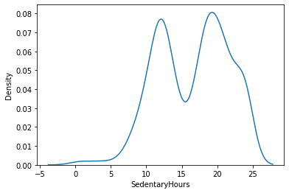
Sedentary hours peaks at 12 and 20, So most of the users are either students or working professionals

Slide 6
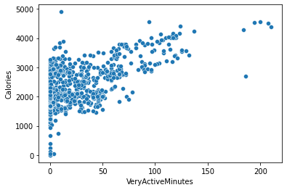
We can see there’s increase in calories burnt with increase in very active minutes

Slide 7
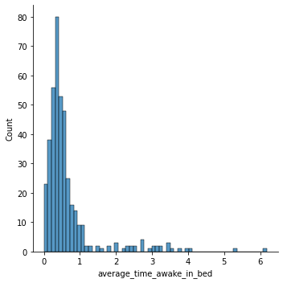
Most users spend on an average of half an hour staying awake in bed

Slide 8
Solution
Most of the users are are in the age between 17-34. So advertisements through social media platform would be an effective strategy.
Promoting our product through brand Ambassadors, social media influencers, advertisements and creating social CRM are effective way to create a marketing campaign.
Develop an app that seamlessly connect to user’s mobile device.
Send personalised notifications through the app to remind them to sleep.
Bill boards and banners can be placed at roadside, public transport where working people usually commute.
Allow users to set goal that enables them to do a certain activity on a day to day basis.

